Slide 1

Dual Enrollment
Next Steps
CONGRATULATIONS ON BEING ACCEPTED
TO THE SPRING 2025 SEMESTER!!

Slide 2
You are accepted!! What will happen now….
As a Dual Enrollment student, you must check your ATLAS email on a regular basis. Valencia and your professors will only communicate with you through this email.
Once scores are uploaded to Valencia College you will receive an acceptance email to the email on your application to create your ATLAS account.
Within 48 hours from creation of your ATLAS account Valencia will email you the link to access the Orientation course.
  You will not be able to register for any classes until you complete the Orientation class, and an Orientation Hold will be placed on your account until done.
Keep checking the Registration Tab in your ATLAS account and your ATLAS email for your registration time.

Slide 3
Maintaining Eligibility for Dual Enrollment
Maintain a Valencia GPA of 2.0 or higher.
If your Valencia term GPA falls below 2.0, you will be placed on academic warning. To be removed from academic warning at the end of the next term, you must achieve a minimum term and cumulative GPA of 2.0.
You may only retake courses that were completed with a D, F, or W for grade forgiveness.
Please be aware third attempts for Dual Enrollment courses are not permitted.
If your Valencia term GPA falls below 2.0 for two successive terms, you will be placed on academic probation resulting ineligibility to continue in the Dual Enrollment program. You may return to Valencia to pursue your educational goals after high school graduation.

Slide 4
Maintaining Eligibility for Dual Enrollment
Dual Enrollment students are permitted to withdraw from one class during program participation. Stay familiar with academic calendar for the drop and withdrawal deadlines for each term.
High School Academic Standards
If your high school cumulative GPA falls below a 3.0, your Dual Enrollment participation will be temporarily suspended. Your school counselor must notify the Dual Enrollment Office when your unweighted high school GPA returns to a 3.0 or higher to be reinstated.
Seek Help: Valencia offers: Tutoring services, counseling services, and additional learning support resources are available to Dual Enrollment students with no cost!

Slide 5
Registration Reminders
You may take online, mixed-mode, real-time virtual, and/or on campus classes.
  If you are age of 15 or younger you cannot take any courses on the Valencia College campus.
Dual Enrollment students may register for up to 13 credits for fall and spring semesters 7 credits in the summer.
As a Dual Enrollment student, you are responsible for creating your class schedule and registering via your Valencia account.
Always share your Valencia schedule with your school counselor and parent/legal guardian.
We strongly encourage students not to exceed a total of 6 courses between Valencia College and high school.
It is helpful to do an Advanced Search so that you can choose specific class details, such as Full Term, modality, and professor.

Slide 6
Ineligible Courses
As a Dual Enrollment student, you are not permitted to register for the following courses.
Courses less than three (3) credit hours
Flex start courses in fall or spring terms
Bachelor Degree program courses
Limited access degree programs (Nursing, Police Academy, Fire Fighter, etc.)
Developmental/remedial or physical education courses
Third attempts for a course

Slide 7

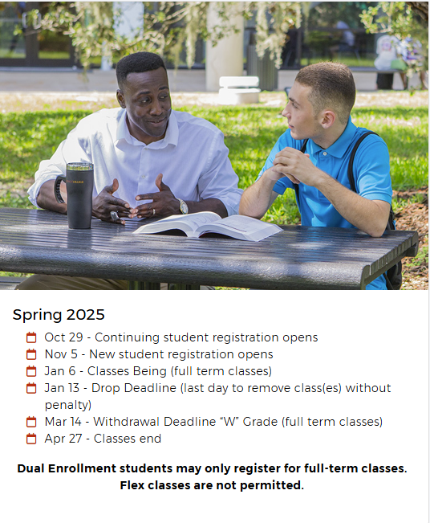
Valencia Courses Deadline
You may add classes to your schedule until the first day of the start of the semester. Space is limited.
You may drop your class(es) only within the drop deadline period. Stay familiar with the important dates and deadlines on the Academic Calendar for each term.
Once the drop deadline has passed, any courses that are removed from your schedule will be a withdrawal. Dual Enrollment students are only permitted to one have withdrawal to remain eligible for the program.

Slide 8
Spring 2025 Scheduling
You cannot drop any AP/AICE or core courses that you are currently taking at Harmony High School.
Must take courses within your cohort year during your freshman and sophomore years. These are crucial academic foundation and testing years. Students will not have the FAST Reading until 10th grade and cannot take it sooner.
Must take 1 course with Dual Enrollment within 2 semesters otherwise you will be coded as inactive and must reapply.
A recommendation is to ease into the DE program would be:
  SLS 1122: New Student Experience, a course that acclimates students to the college experience.

Slide 9
Potential Valencia Courses to Enroll in
Term: 1 | Spring (9th & 10th Grade Year)
Course Code | Name | Credits
LIT 1000 | INTRO TO LITERATURE | 3
SLS 1122 | NEW STUDENT EXPERIENCE | 3
SPC 1608 | FUNDAMENTALS OF SPEECH | 3
HUM INST | HUMANITIES INSTITUTIONAL SELECTION | 3
Term: 1 | Spring (11th & 12th Grade Year)
Course Code | Name | Credits
SLS 1122 | NEW STUDENT EXPERIENCE | 3
SPC 1608909 | FUNDAMENTALS OF SPEECH | 3
HUM INST | HUMANITIES INSTITUTIONAL SELECTION | 3
LIT 1000 | INTRO TO LITERATURE | 3

Slide 10
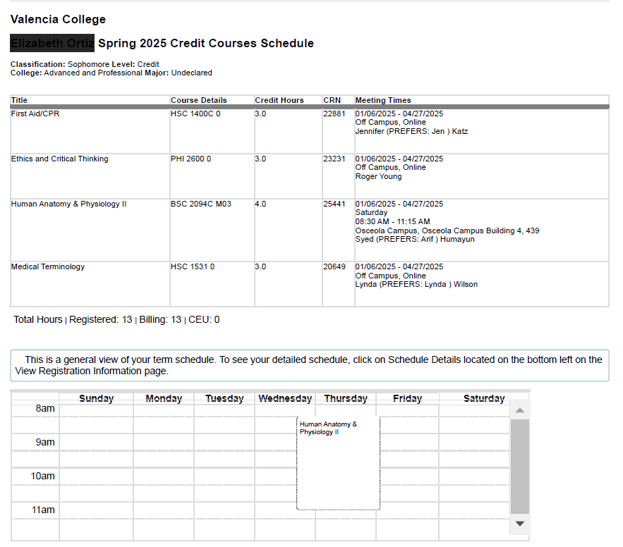
CONTRACT DETAILS
On Back of Student Contact Sheet
Must be turned into Guidance
You do not pay for books for DE classes through the Osceola County School District Bookstore on Bill Beck Blvd in Kissimmee.
You will receive the required materials only. Any optional books within the class that you would like, you would need to purchase.
All courses must start on the first day of classes at Valencia College. Anything other than the first day of school will not be approved.
If you are not scheduled into a class period at Harmony High School, you cannot be on campus. If found on campus without a scheduled period, you will be scheduled into one. This is for safety purposes.

Slide 11
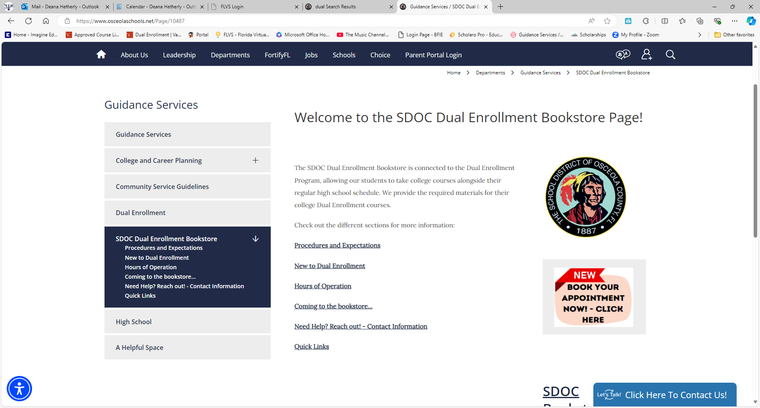
Contract Details (cont’d)
Must have Student Detailed Schedule approved by your School Counselor before going to the District bookstore. Make sure that you have an email receipt that the schedule has been sent to the bookstore.
Make sure you are checking the Osceola County School District Dual Enrollment page and join their REMIND, as well.
There are 3 REMINDS you need to join, especially full-time DE students:
  Your Graduation Class REMIND
  Harmony High School DE REMIND
  SDOC DE Bookstore REMIND

Slide 12
Dual Enrollment Warnings
If you drop a Dual Enrollment course, you must alert your School Counselor. If you do not do this could restrict the courses taken the next semester. Dropping a course may mean an additional course at the High School.
Two (2) Withdrawals within your Valencia College transcript will mean removal from the program and could negatively impact your financial aid in the future.
Must be completing 3 credits each semester. These credits can be completed in 3 different scenarios:
All Courses at Valencia College - 4 Classes is considered full time
Combination of Valencia College and Harmony High School
Combination of Valencia College, Harmony High School and online
You CANNOT be just Valencia College and online school, this is considered Home Schooling, and you would need to withdraw from Harmony High to complete this combination.

Slide 13
Dual Enrollment Warnings
If you become a full time Dual Enrollment student, 4 classes at Valencia College and None at Harmony High School, it is your responsibility to make an appointment with your School Counselor to complete a credit check each semester. Your DE Student Detailed Schedule will not be approved without a meeting.
A Student MUST maintain a 3.0 high school GPA and a 2.0 Valencia College GPA to remain in the program. If the high school GPA goes below the 3.0 your School Counselor will alert Dual Enrollment for removal from the program.
Failure to maintain good standing could impact future ability to earn scholarships, financial aid and even loans after high school.
If you are planning on earning your AA degree, you MUST meet with a Valencia DE Academic Advisor to check graduation status and apply for graduation through your Valencia ATLAS account. Failure to do this could prevent you from earning your AA degree.

Slide 14
Important Links To Remember
Osceola County District Bookstore: Guidance Services / SDOC Dual Enrollment Bookstore
Valencia College Approved Courses: Dual Enrollment Course List | Valencia College
Valencia College Degree Pathway: Degree Pathways | Valencia College
Student Detailed Schedule Directions: How to Save a PDF for your SDS_24-25.pdf

Slide 15
REMIND CODES
TEXT ALL REMIND CODES TO 81010
Harmony High School Class REMINDS –
  Freshman Class - @28harmony
  Sophomore Class - @27harmony
  Junior Class - @26hhs
  Senior Class - @25harmony
Harmony High School DE REMIND - @deharmony
DE District Bookstore REMIND – @destu

